Slide 1



Thynk Unlimited
Learn More

Slide 2


Thynk Unlimited

Slide 3

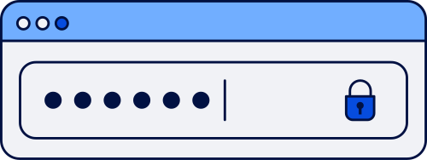
Thynk Unlimited
Malware
Phising
DDoS Attacks
Zero-day Exploits
Man-in-the-Middle Attacks

Slide 4





Thynk Unlimited

Slide 5
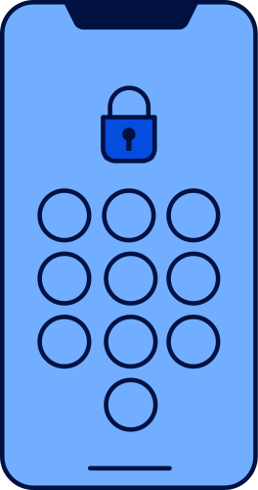

Thynk Unlimited

Slide 6
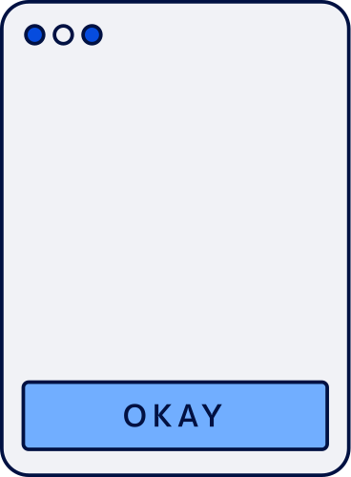

Thynk Unlimited

Slide 7

Thynk Unlimited

Slide 8





Thynk Unlimited

Slide 9
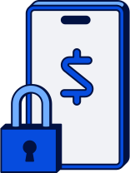

Thynk Unlimited

Slide 10





Thynk Unlimited

